Slide 1
Week 8 Console Applications
Notes:
Welcome to Week 8 of Programming, where we will make the transition from Processing to console application in IntelliJ

Slide 2



Outline
Console Applications
Gathering User Input

Slide 3

Console Applications
So far in this unit, we’ve looked at the fundamentals of Programming from a visual perspective to create graphical applications, by drawing shapes and developing simple games
The Processing Integrated Development Environment (IDE) allowed us to use the Java syntax (rules and style of Java) to develop such applications
This week, we’re going to move our focus to console applications
Console applications do not involve a graphical interface, meaning they are fast to develop and allow us to focus more on the logic

Slide 4

IntelliJ
In the labs this week you will be using another IDE called IntelliJ
IntelliJ is an incredibly popular IDE for developing Java applications
This is the sort of IDE you would be expected to be familiar with in industry
Quite complex - lots more buttons than Processing, but equally more powerful (better debugging capabilities, can integrate with Version Control Systems and has testing capabilities built-in)

Slide 5
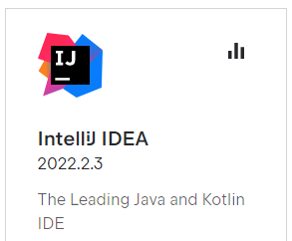


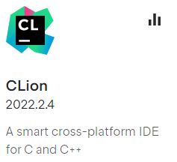
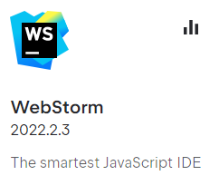
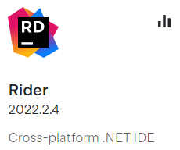
IntelliJ
IntelliJ is developed by a company called JetBrains, which have many IDEs that are each suited to a particular programming language

Slide 6
IntelliJ
IntelliJ and other JetBrains IDEs have a consistent interface – this makes learning other languages less daunting if you have a similar interface to develop in
Java can be used to write all kinds of applications
E.g. web server, mobile apps, console apps
All Java code is object-oriented (OO) – code is contained in classes, of which we create objects of. These objects then communicate to each other through the object’s methods
Console applications need to know where to start – which class?
In Processing – setup, then draw
In Console applications – main method

Slide 7
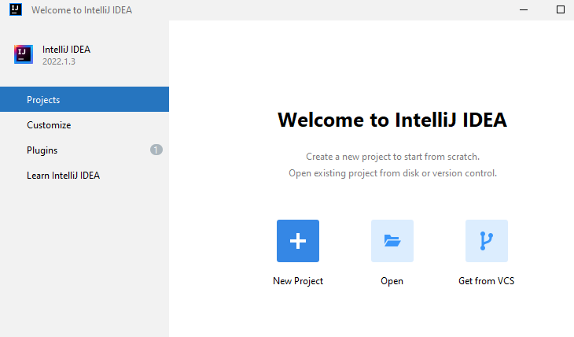
IntelliJ
Default theme is a dark one, I’ll be using the light theme to make things a little easier to read
You will create a New Project each week – this project appears as a folder in your file system

Slide 8
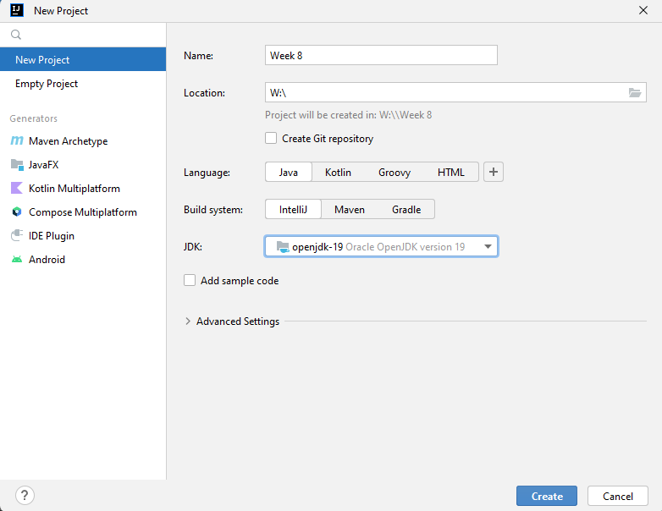
IntelliJ – Creating a Project
Name of the project – Week 8 in this case
Location of the project on file system – do not use OneDrive ( O:\ )
You have access to a dedicated W:\ drive when on campus
Keep these defaults
You will create a New Project each week – this project appears as a folder in your file system
Create

Slide 9
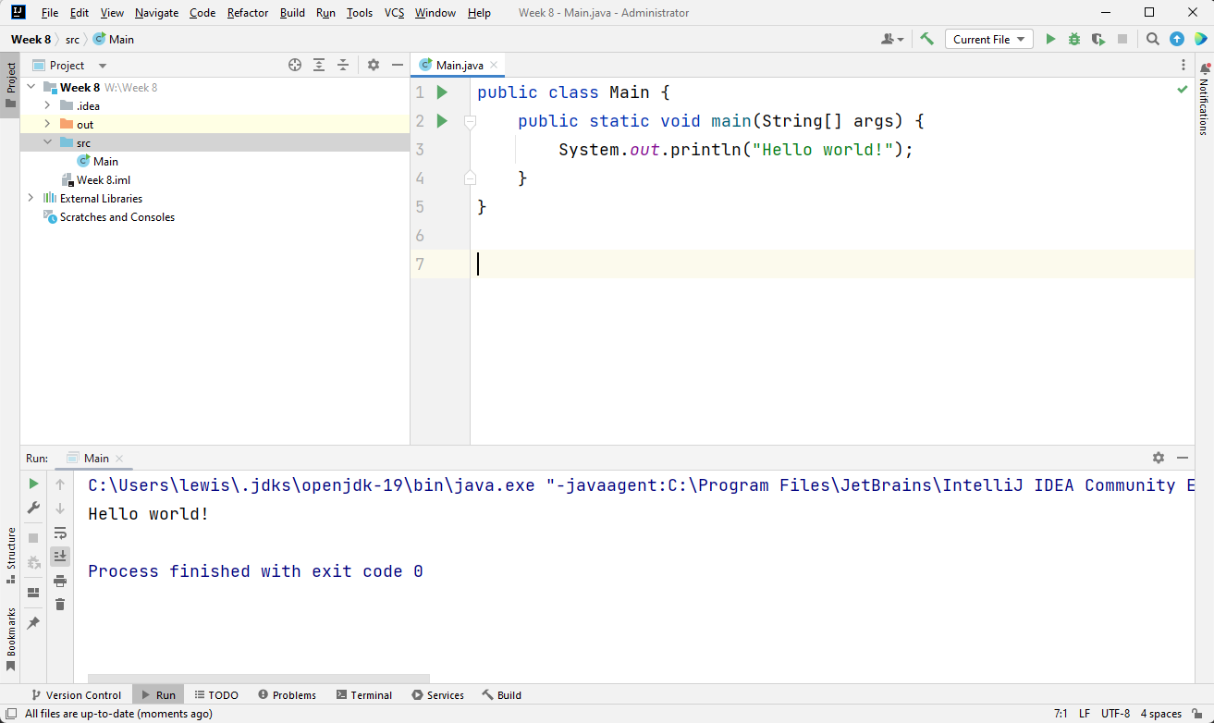
IntelliJ
Project Explorer
Editor
Output

Slide 10
IntelliJ
Project Explorer (shows which projects we have open)
All of the code we write (source code) will be stored in src

Slide 11
IntelliJ

Slide 12
IntelliJ
Code Editor window
All the code we’ll be writing will be in classes
public – access modifier (we’ll look at this more later in the unit). public means accessible anywhere in the application
The class name can be anything as long as it’s a valid identifier (name).
public static void main (String[] args)
Think of this as being like void setup in Processing. Program execution will start with the main method

Slide 13
IntelliJ

Slide 14
IntelliJ
Console Window
Shows the output of our code – in this case, the output of:
System.out.println(“Hello world!”);

Slide 15
Printing to the Console
System.out.print();
Prints a string message to the console
System.out.println();
Prints a string message to the console and moves to the next line (adds a carriage return)
An empty println statement will simply print out a blank line

Slide 16
Lab sheet Exercise 1.
Create and run a hello world application using IntelliJ
Amend this to display
Hello <yourname>
How are you?

Slide 17
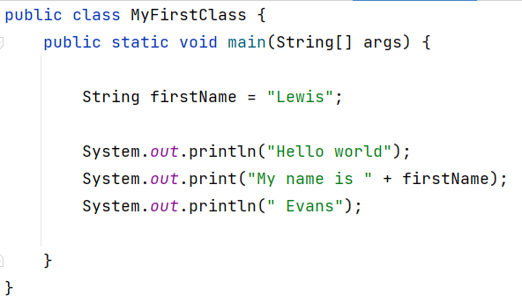
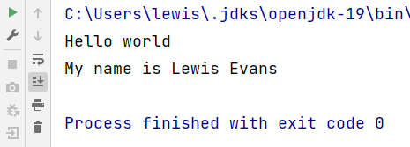
Printing to the Console
As mentioned earlier, we can call the class anything provided it’s a valid identifier
Can use + operator to join two Strings together – string concatenation

Slide 18
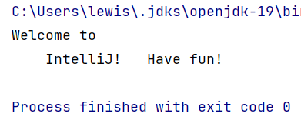
Escape Sequences
When dealing with Strings, we can use special characters which have a special meaning called escape characters and prefix them with a backslash \ to form an escape sequence – a signal to Java to interpret differently
\n – will be replaced with a new line
\t – will move the screen cursor to next tab stop
public class EscapeSequenceDemo { public static void main(String[] args) { String message = "Welcome to\n\tIntelliJ!\tHave fun!"; System.out.println( message ); } }
Notes:
Try this

Slide 19
Exercise 2 – Using variables
Try the debugger

Slide 20
Gathering User Input

Slide 21

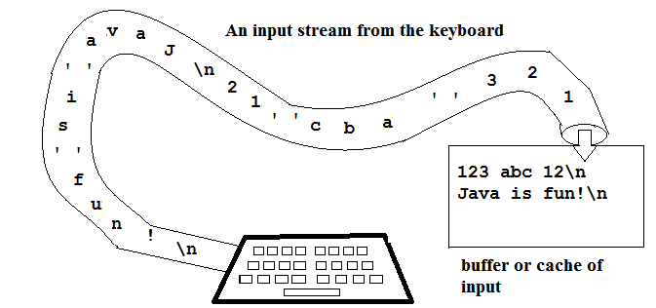
Gathering User Input
Most meaningful applications accept input from a user
In Java Console applications, Input/Output (I/O) is handled by streams
A steam can come from (or go to) many data sources – default is the keyboard
All keyed input is stored in a stream – we can then retrieve the input using various commands (methods)
A stream could also contain characters we don’t want – e.g. carriage returns, spaces, tabs
To gather input, we can use one of Java’s built-in classes – Scanner class

Slide 22
The Scanner class
The Scanner class is part of the Java library, and allows us to read input (of many types), which can then be stored in variables
To use a class from the java library, we need to import it into our program by using an import statement
There are thousands of classes in the standard Java library, and these classes live in packages – a package is simply a folder of related classes
The Scanner class lives in a package called java.util (Java utilities)

Slide 23
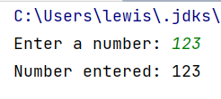
Scanner Demo
Import Statement
Tell the program that we want to use the built-in Scanner class from the java.util package
import java.util.Scanner; public class ScannerDemo { public static void main(String[] args) { // create a Scanner object and assign to variable keyboard Scanner keyboard = new Scanner(System.in); System.out.print("Enter a number: "); int number = keyboard.nextInt(); // read next int and store in variable keyboard.close(); // close the stream - we're finished using it System.out.println("Number entered: " + number); } }
Create Scanner object
Create an object (instance) of the Scanner class, and “hook it up” to System.in (default keyboard)
Prompt User
Prompt user to enter a number
Read Integer
Read integer from keyboard using nextInt() method (part of the Scanner class)
Print Result
Prints the value fetched and stored in number variable.
+ concatenates

Slide 24
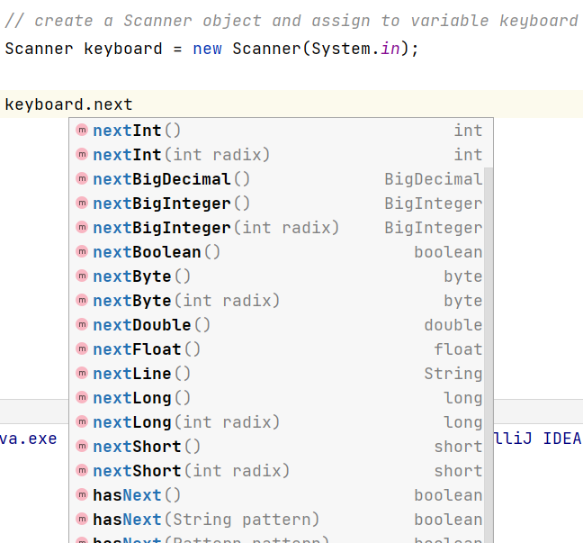
Other Scanner Methods
The Scanner class has many methods to collect different types of inputs
nextInt() fetches the next int
nextFloat() fetches the next float
next() fetches the next String
nextLine() fetches the next group of Strings until it sees a new line or carriage return

Slide 25
Exercise : Input
Create an application that allows a user to enter their name, age and height and displays the information on the consle.

Slide 26
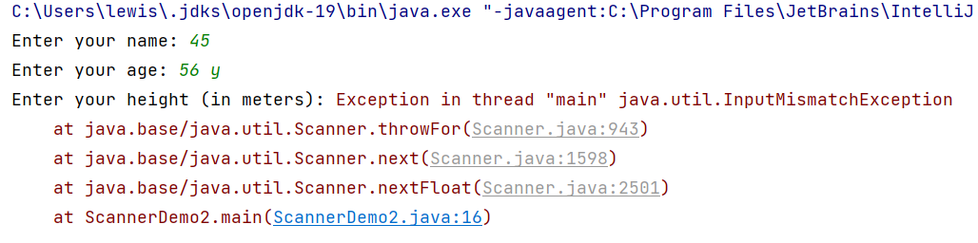
Input Mismatch
What happens if we fetch the next integer from the stream but it turns out the next thing wasn’t an integer at all?

Slide 27
Input Mismatch
1st input expects a String, so it reads 45 as “45”
2nd input expects an integer and grabs 56 from the stream
3rd input expects a floating point number but we get an error due to “y” being left in the input stream
Input validation techniques can be used to resolve this (Webinar B this week)

Slide 28


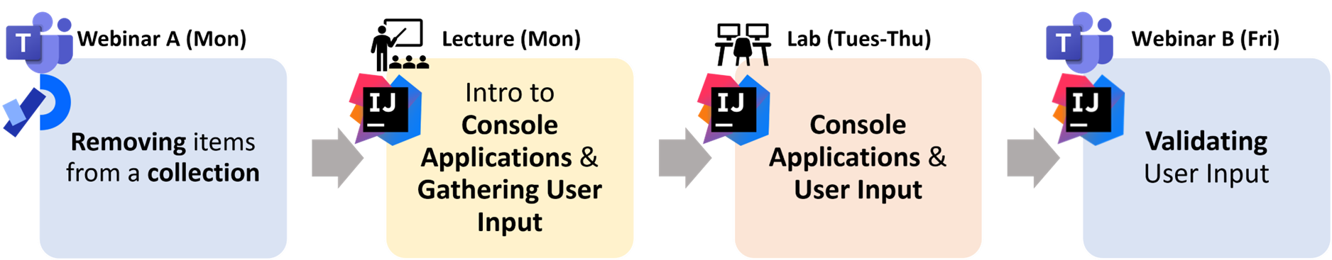
Summary
This week – moving over from Processing to a more sophisticated IDE, IntelliJ
Console output – print/println
Streams – input/output
Scanner class – a built-in Java class that allows us to gather user input from the keyboard using the Scanner object’s methods – e.g. nextInt() nextLine()

